Slide 1
Cinema booking
Ilija Popovic K12144485

Slide 2
Project idea
The idea is that users can go to this website on their personal computer, mobile phone, tablet, or any other device and easily book and manage their movie tickets.

Slide 3
Technologies
JavaScript (jQuery)
HTML
CSS
PHP
MySQL

Slide 4
Development
Backend
Frontend
MySQL
PHP
HTML
CSS
JavaScript

Slide 5
Target users
Clinet
Admin

Slide 6
Client side
Functions: - Registration
- View of all moves that are currently showin and that are coming soon
- View movie page
- View proections in all cinemas
- Book a ticket for the given projection
- Comment and leave a grade for the movie
- View his booked tickets
- View and edit his profile
- View of all cinemas and their halls
- View of pricelist

Slide 7
Admin side
Functions:
- add/change/delete projections
- add/change/delete movies
- add/change/delete cinemas
- add/change/delete halls

Slide 8
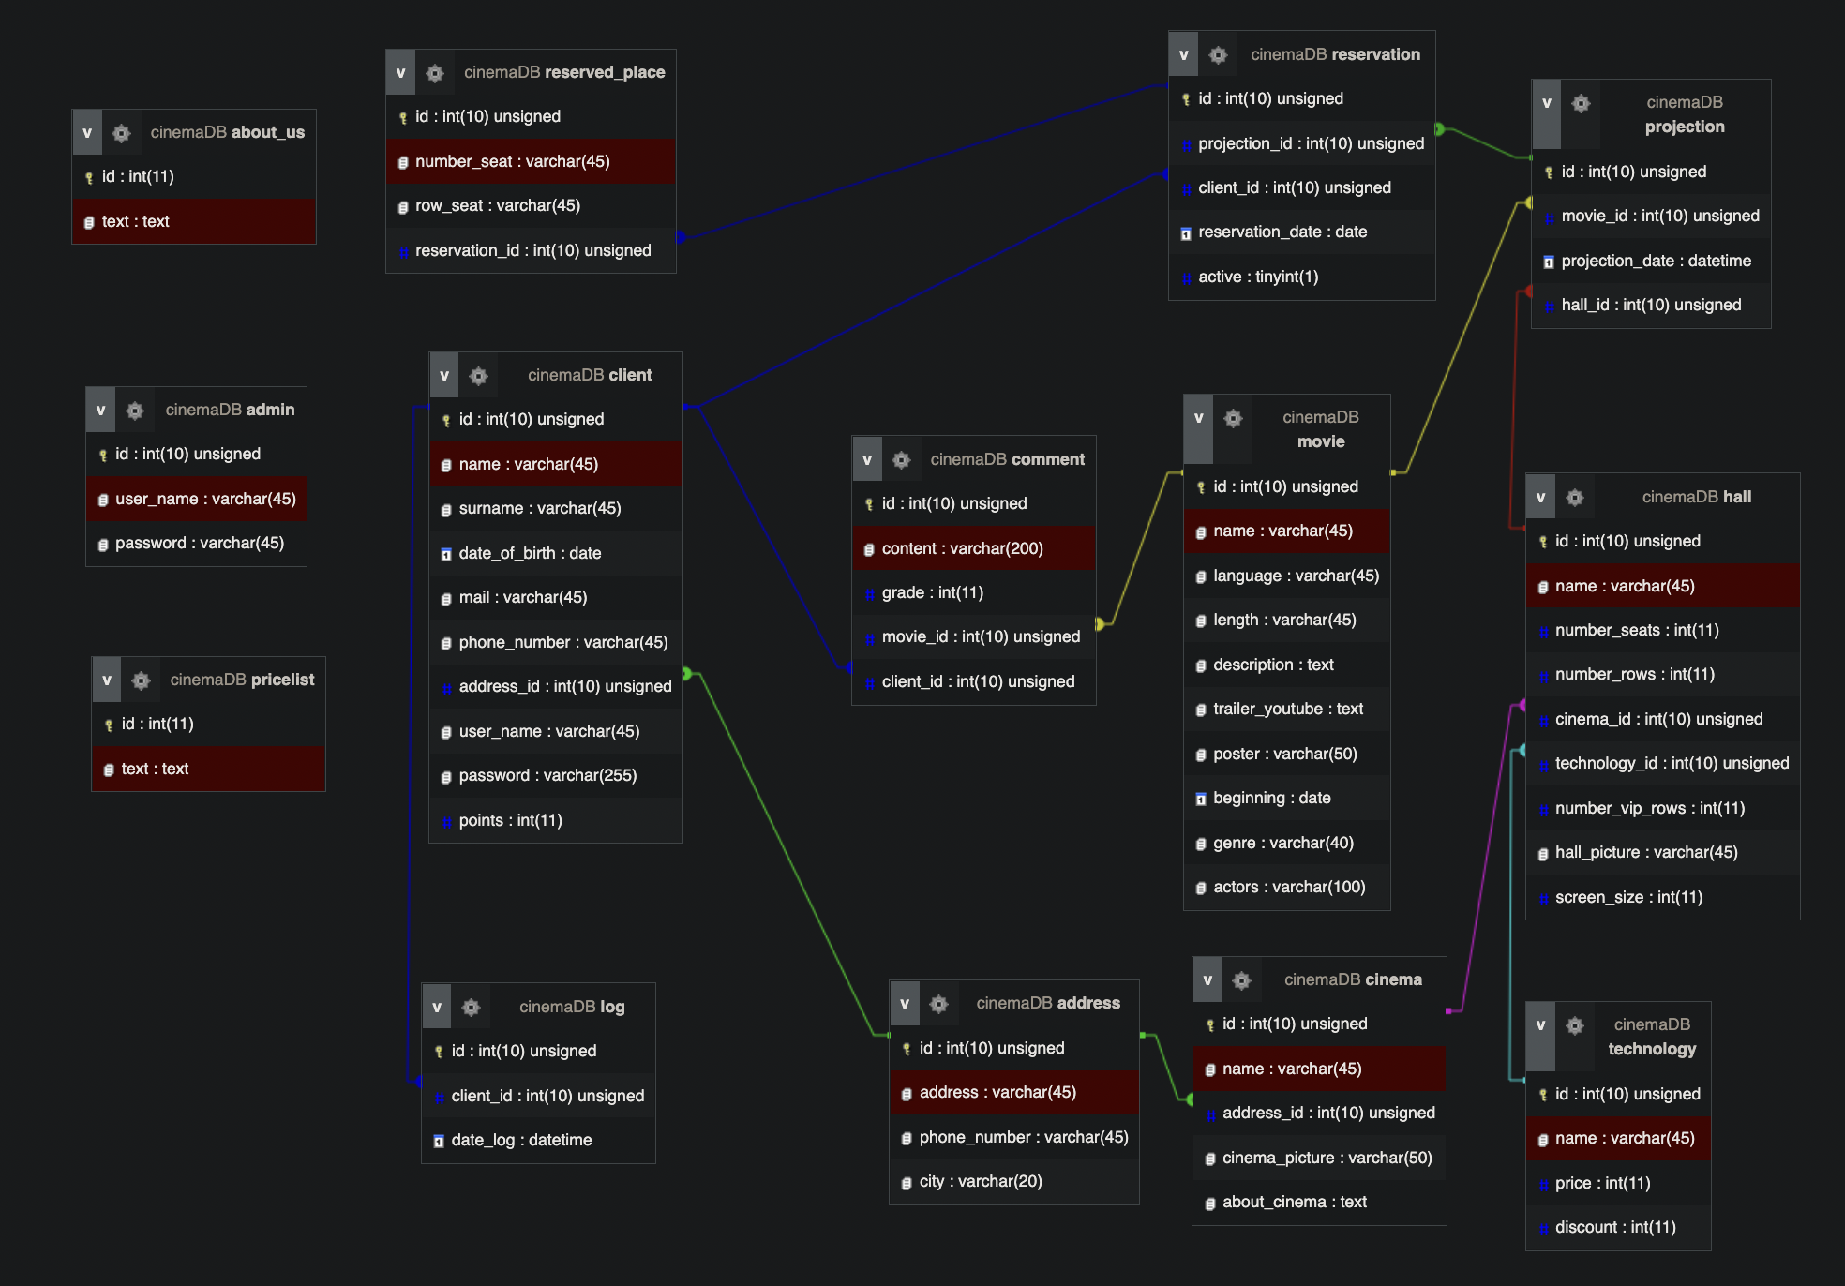
Database

Slide 9
Demo

Slide 10
Thank you!

